Slide 1

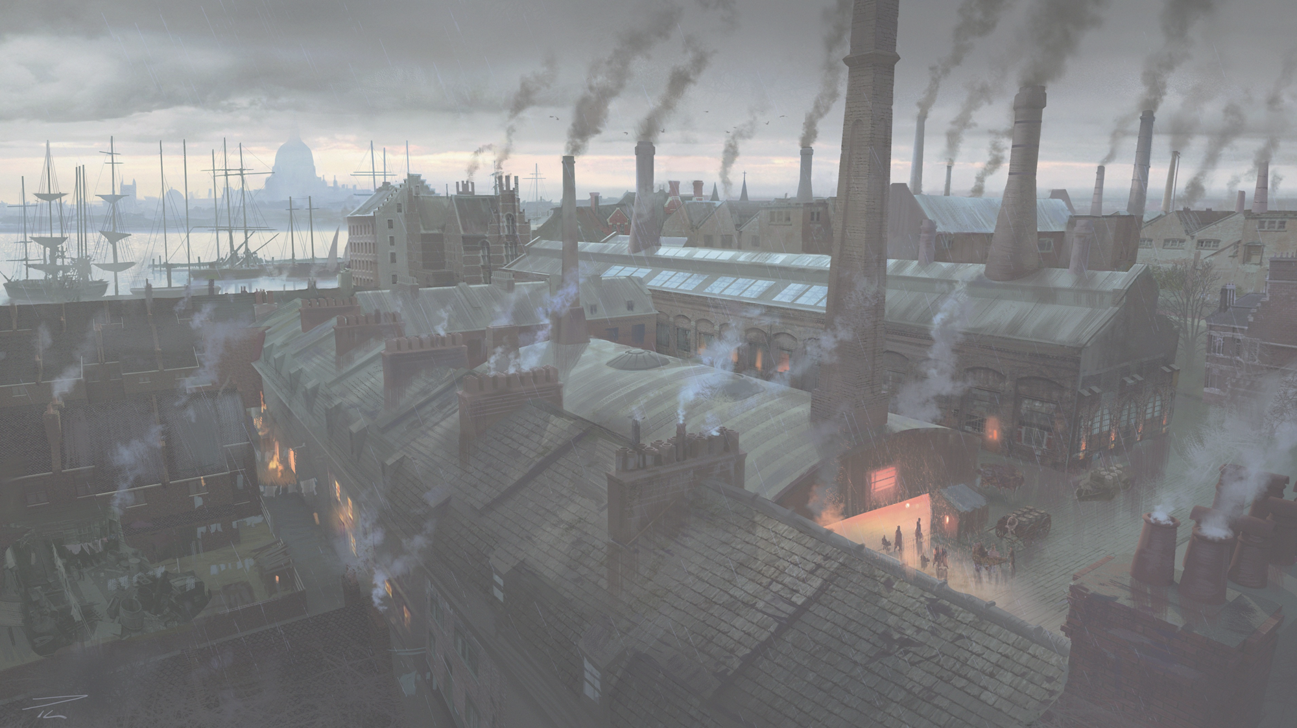





1750 to 1900
Chapter 16
THE INDUSTRIAL AND AGRICULTURAL REVOLUTION
the industrial and agricultural revolution
Strand Three: The History of Europe and the Wider World
@MsDoorley

Slide 2
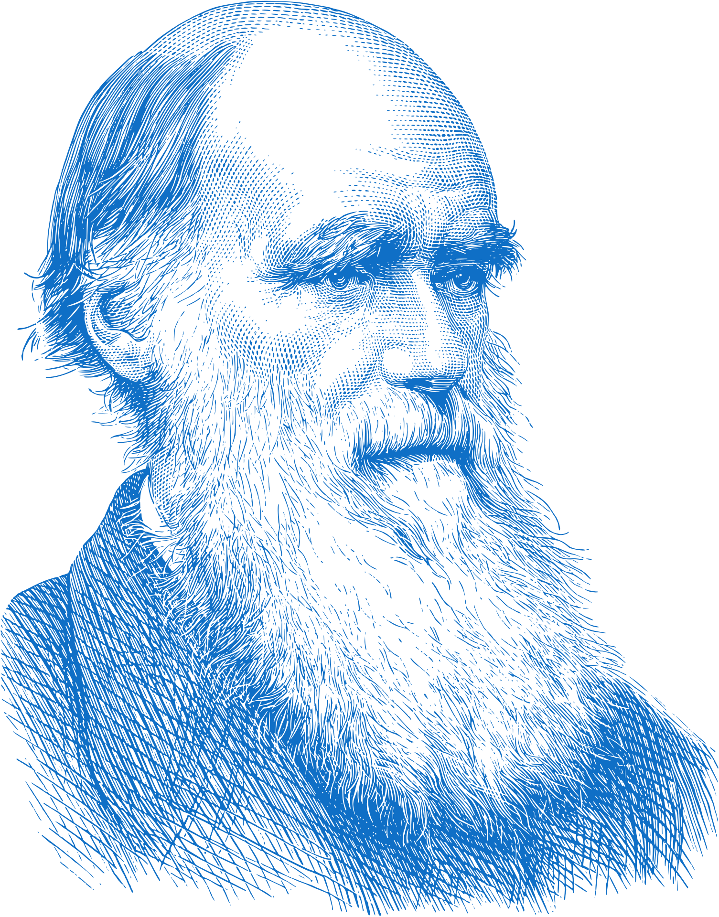

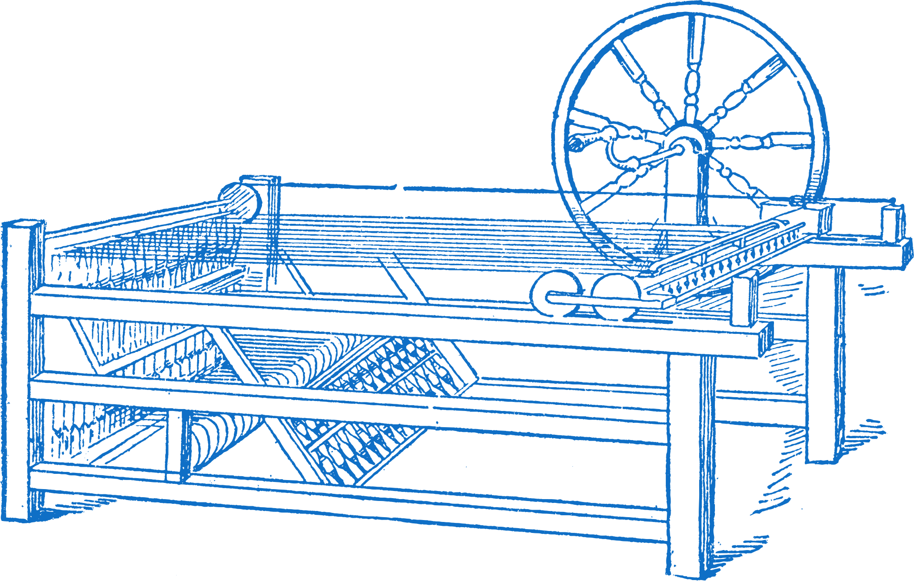

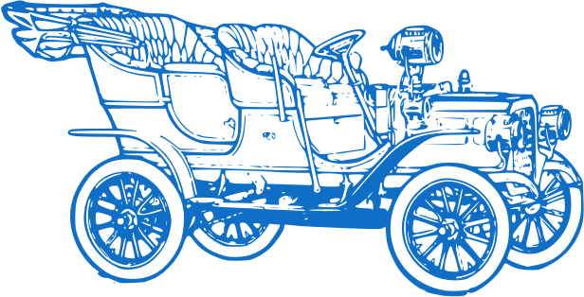

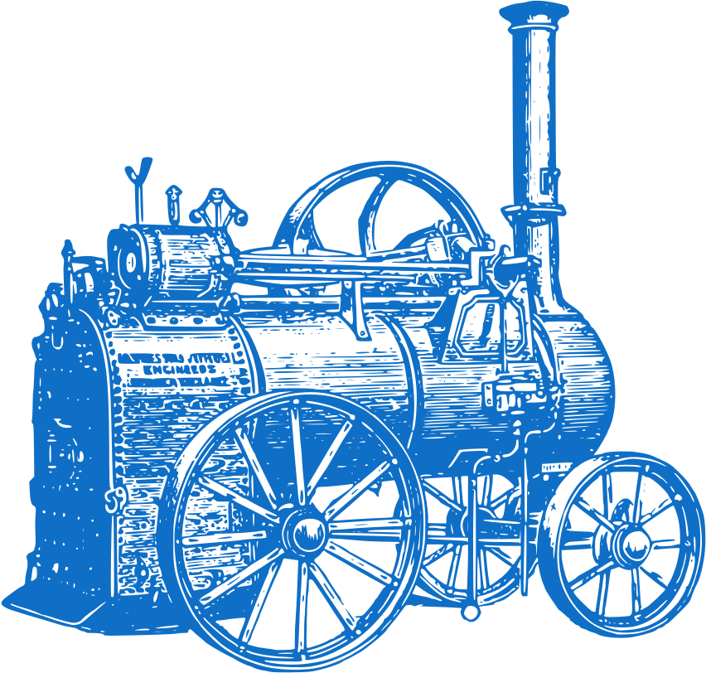
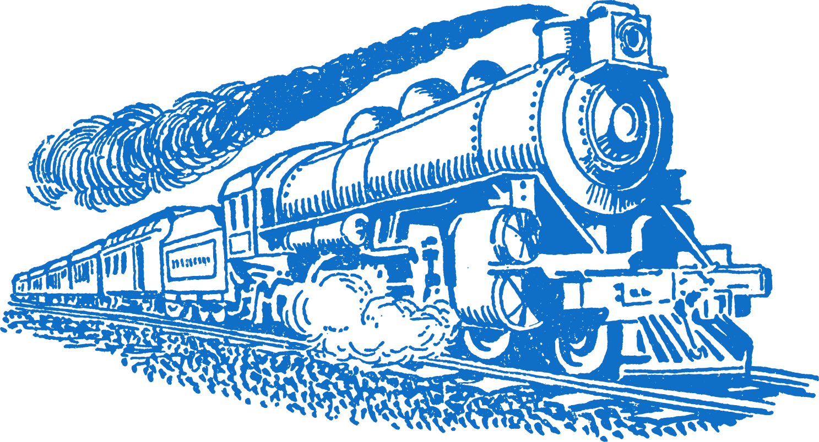


Chapter 16
THE INDUSTRIAL REVOLUTION
James Hargreaves invents the Spinning Jenny
The Origin of Species is published by Charles Darwin
The first automobile was invented.
1763
1764
1796
1859
1866
1886
1900
Strand Three: The History of Europe and the Wider World
Chapter Sixteen: The Industrial Revolution
Rotary Steam engine – James Watt improved the steam engine so it could be transported and used
Edward Jenner creates the vaccine for smallpox, the first eradicated disease
Alfred Nobel invents dynamite.
The Zeppelin is invented.

Slide 3
Learning Outcomes
3.11 EXPLORE the contribution of technological developments and innovation to historical change
3.14 ILLUSTRATE patterns of change across different time periods in a chosen theme relating to life and society (such as crime and punishment; food and drink; work and leisure; fashion and appearance or health and medicine)
Strand Three: The History of Europe and the Wider World
Chapter Sixteen: The Industrial Revolution
@MsDoorley

Slide 4
Introduction
In the first half of the 18ᵗʰ Century, Britain was mainly an agricultural country. However, from 1750 onwards, this would change. Over the next 100 years, Britain became the first country to go through an Industrial Revolution: goods were now made in factories. Britain became the richest country in the world as well as experiencing social changes (in the way people lived). New towns and cities were established and by 1850 more than half the people of Britain were living in cities. These changes were partially caused by technological change, contributing to patterns of change in crime and punishment as well as health and medicine.
Strand Three: The History of Europe and the Wider World
Chapter Sixteen: The Industrial Revolution
@MsDoorley

Slide 5
1750 to 1900
Chapter 16
16.1: TECHNOLOGICAL AND HISTORICAL CHANGE
16.1: technological and historical change
Strand Three: The History of Europe and the Wider World
@MsDoorley

Slide 6
Causes of the Industrial Revolution
Rising Population
There were many causes of the Industrial Revolution which began in Britain in the middle of the 18ᵗʰ Century. One of the most important causes was the invention of the steam engine. The steam engine contributed to huge historical change in the 18ᵗʰ and 19ᵗʰ centuries.
Transport Revolution
Profits from trade
Strand Three: The History of Europe and the Wider World
Chapter Sixteen: The Industrial Revolution
Coal and Iron Ore
Agricultural Revolution
Manufacturing Inventions
Diagram taken from Making History, 2nd Edition by Stacy Stout and Dermot Lucey (Gill Education)
@MsDoorley

Slide 7
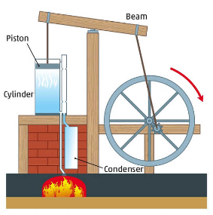
Steam Power
The steam engine was the most important invention of the Industrial Revolution. Steam engines built by Thomas Newcomen were first used to pump water out of mines with James Watt making improvements to the early steam engines.
His most important improvement was the addition of a flywheel. The old steam engines had only an up-and-down motion (movement). Watt’s engine had a rotary (turning) motion. Now steam engines could be used to power other machines, allowing steam engines to power factories.
Strand Three: The History of Europe and the Wider World
Chapter Sixteen: The Industrial Revolution
Diagram taken from Making History, 2nd Edition by Stacy Stout and Dermot Lucey (Gill Education)
@MsDoorley

Slide 8
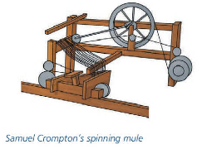
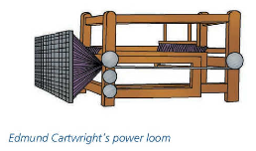
Domestic Industry to the Factory System
The steam engine was used to power new inventions for making thread and cloth, such as Crompton’s spinning mule or Cartwright’s power loom. These inventions speeded up the manufacture of cloth. The new machines were also bigger than the old spinning wheel and hand loom and were powered by water wheels (and later by steam engines). This meant that they could only be used in mills and factories rather than houses. This led to the growth of factories in cities in Britain.
Strand Three: The History of Europe and the Wider World
Chapter Sixteen: The Industrial Revolution
Diagram taken from Making History, 2nd Edition by Stacy Stout and Dermot Lucey (Gill Education)
@MsDoorley

Slide 9
Railways
The invention of the steam engine speeded up the transport revolution. Britain depended on carts and canals for transporting goods; the development of the railways changed all that. The first railways were built to haul coal from coal mines but these railroads used huge stationary steam engines. When Richard Trevithick designed a small engine on wheels, the Railways Age had begun. In 1825, the first goods train ran between Stockton and Darlington, built by George Stephenson. The first passenger line was built between Manchester and Liverpool – George and Robert Stephenson’s Rocket ran this line.
Strand Three: The History of Europe and the Wider World
Chapter Sixteen: The Industrial Revolution
@MsDoorley

Slide 10
The Impact of the railways
  Wars become bloodier and more destructive.
  Trains were used to transport huge numbers of soldiers to the battlefronts. Armies grew from thousands to millions by the time of World War I. More soldiers were killed and wounded with each war.
  Trains were also used to supply ammunition, food and clothes to the soldiers.
  The factories powered by steam engines produced the weapons, ammunitions, clothes and food for the new larger armies.
Strand Three: The History of Europe and the Wider World
Chapter Sixteen: The Industrial Revolution
@MsDoorley

Slide 11
The Impact of the railways
  The growth of railways in Britain had a huge impact:
    Faster, cheaper and more comfortable transport.
    Decline of coaches and canals
    Growth of industry – more coal, iron and engines.
    Growth of towns and cities – more people came to shop; people lived in suburbs.
    Growth of tourism – daytrips to seaside resorts.
  The steam engine was the single most important invention, which spurred on the great historical changes of the industrial revolution.
Strand Three: The History of Europe and the Wider World
Chapter Sixteen: The Industrial Revolution
@MsDoorley

Slide 12
Questions pg. 457 (Making History, 2nd Edition)
  Name two inventors involved in the development of the steam engine.
  How was industry powered before the steam engine?
  How did steam engines influence mining?
  Name one other machine that could be powered by Watt's steam engine.
  Name two examples of cities that grew during the Industrial Revolution.
  Why did cities grow during the Industrial Revolution?
  How was their growth connected to the impact of the steam engine?
  Where were the first public railways built?
  How did steam engines make wars more bloodier and more destructive.
Strand Three: The History of Europe and the Wider World
Chapter Sixteen: The Industrial Revolution
@MsDoorley

Slide 13
Questions pg. 457 (Making History, 2nd Edition)
  James Watt and Thomas Newcomen
  By hand until the first steam engines which had only an up-and-down motion (movement).
  The flywheel steam engine used rotary motion to improve the production process.
  The Power Loom
  Manchester and Liverpool
  Factories were located there so people moved from rural areas into the cities.
  Steam engines powered the factories.
  In 1825, the first goods train ran between Stockton and Darlington while the first passenger line was built between Manchester and Liverpool.
  Trains were used to transport huge numbers of soldiers to the battlefronts. Armies grew from thousands to millions by the time of World War I. More soldiers were killed and wounded with each war.
Strand Three: The History of Europe and the Wider World
Chapter Sixteen: The Industrial Revolution
@MsDoorley

Slide 14
1750 to 1900
Chapter 16
16.2: CRIME AND PUNISHMENT IN 19ᵗʰ CENTURY INDUSTRIAL SOCIETY
16.2: crime and punishment in 19ᵗʰ century industrial society
Strand Three: The History of Europe and the Wider World
@MsDoorley

Slide 15
Social Change
Britain experienced great social changes from the late 18ᵗʰ Century through the 19ᵗʰ Century. The population increased dramatically from about 7 million in 1750 to 42 million in 1900. More and more of this population lived in towns and cities. As the cities grew, the rich and the poor separated – the rich went to live in the suburbs while the poor lived in overcrowded conditions in the city centres. These changes were accompanied by increased crime, drunkenness and violence.
Strand Three: The History of Europe and the Wider World
Chapter Sixteen: The Industrial Revolution
@MsDoorley

Slide 16
Who made the law?
  During the 18ᵗʰ Century, governments looked on punishment as a deterrent to stop people from committing crimes.
  In Britain this was the time of the Bloody Code when more and more crimes were punished by execution.
  By the early 19ᵗʰ Century, over 200 offences such as sheep-stealing, poaching and theft were capital offences – punishable by hanging.
  It was clear that this was not working as the crime rate continued to rise, leading to the government having to change its approach and its laws.
  They were influenced by John Howard, who wrote The State of the Prisons in England and Wales, and by Elizabeth Fry, who visited women in Newgate Prison in 1813. They advocated prison conditions and introducing worthwhile activities for the prisoners.
  Sir Robert Peel, who was Home Secretary in the 1820s and later Prime Minister, began the process of change while overcoming resistance by Members of Parliament.
  Some believed that governments should no interfere or intervene in the economy or society; they also did not want to see increased taxation.
Strand Three: The History of Europe and the Wider World
Chapter Sixteen: The Industrial Revolution
@MsDoorley

Slide 17
Who enforced the law?
Prior to the 19ᵗʰ Century, policing was the responsibility of the local community with volunteer constables and watchmen. The increasing crime rate in London led to changes in policing. In 1829, Sir Robert Peel founded the first professional police force there. The new police – called Peelers – had a distinctive uniform but they were only armed with a baton or truncheon. Their main job was to patrol the streets to prevent crime. Very soon, the example of London spread to all parts of Britain while specialist detective sections were set up to solve crimes.
Strand Three: The History of Europe and the Wider World
Chapter Sixteen: The Industrial Revolution
@MsDoorley

Slide 18
What were the crimes?
  Some of the old crimes such as poaching became less important but newer crimes developed in this rapidly changing society.
  New crimes included: bank robberies (as more banks were set up) and thefts from workplaces (as more goods were being traded).
  There was also white-collar crimes of corruption and cheating.
  The close living conditions of the time resulted in petty theft being the most common crime.
Strand Three: The History of Europe and the Wider World
Chapter Sixteen: The Industrial Revolution
@MsDoorley

Slide 19
What were the punishments?
Attitudes towards punishments changed during the 19ᵗʰ century. People still looked on punishment as a deterrent but also acknowledged that the punishment should match the crime. There was also a change in attitude towards capital punishments (hanging and execution); they believed they were too severe except in the most serious cases of crime. There was also the belief that the crime should improve – rehabilitate – the offender. These new attitudes led to the end of the Bloody Code alongside the introduction of new forms of punishment.
Transportation was one of the new forms of punishment. The first criminals were transported to Australia in 1787. These criminals worked for the settlers for seven years, providing free labour in return for free food and boarding. After that, most former criminals stayed in Australia as they could not afford the passage home. By 1868, over 160,000 people had been transported to Australia. Transportation ended due to the people in Australia did not want to see any more criminals as well as the building of British prisons.
Chapter 16: The Industrial and Agricultural Revolutions
Strand Three: The History of Europe and the Wider World
Chapter Sixteen: The Industrial Revolution
@MsDoorley

Slide 20
Prisons
  Prior to the 19ᵗʰ Century, prisons were only used to hold people awaiting trial. Conditions were usually bad and disease spread quickly. All types of prisoners were grouped together in one space. Robert Peel began the process of prison reform with the Gaols Act 1823 which separated prisoners by gender and category of crime. It also introduced paid wages for gaolers and the removal of chains for prisoners.
  Later improvements included the building of 90 new prisons between 1842 and 1877; the first of these was Pentonville Prison in London. While conditions improved, the manner in which prison life was organised made life difficult for the prisoners. Prisons were run on the Separate System – prisoners were kept in their own cells. Prisons were also run by the Silent System – hard labour in silence (‘hard labour, hard fare and hard board’).
  During the first half of the 19ᵗʰ Century, hangings were held in public; a practice which dated back as far as the Middle Ages. Instead of deterring crime, public hangings had become scenes of laughter and drunkenness – leading to the last public hanging in Britain being conducted in 1868. Hangings also became more effective in killing the victims. In the 1870s, the long drop technique was introduced; this resulted in the neck of the victim being snapped which caused instant death.
Strand Three: The History of Europe and the Wider World
Chapter Sixteen: The Industrial Revolution
@MsDoorley

Slide 21
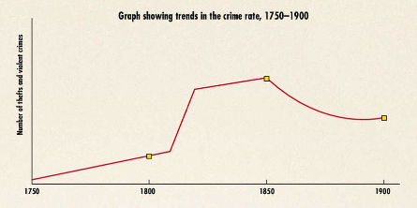
Strand Three: The History of Europe and the Wider World
Chapter Sixteen: The Industrial Revolution
Diagram taken from Making History, 2nd Edition by Stacy Stout and Dermot Lucey (Gill Education)
@MsDoorley

Slide 22
Questions pg. 483 (Making History, 2nd Edition)
  Who made the laws in 18th Century Britain?
  How many offences had hanging as a punishment?
  Name two people who promoted prison reform.
  How did they say prisons should be reformed?
  Who was the Home Secretary who promoted changes in prison conditions?
  Why did some MPs oppose improvements in prison condition.
  What change did Robert Peel introduce in policing?
Strand Three: The History of Europe and the Wider World
Chapter Sixteen: The Industrial Revolution
@MsDoorley

Slide 23
Questions pg. 485 (Making History, 2nd Edition)
  What new crimes were committed in a rapidly changing society?
  What was the most common crime in the 19th Century?
  How did people view punishment of criminals?
  Did people favour hanging as a punishment?
  Where did Britain transport criminals?
  What did they do in that country?
  Name one term of the Gaols Act, 1823.
  Name the first of the 90 new prisons built in England.
  What was (i) the separate system and (ii) the silent system?
  Why were public hangings banned?
Strand Three: The History of Europe and the Wider World
Chapter Sixteen: The Industrial Revolution
@MsDoorley

Slide 24
1750 to 1900
Chapter 16
16.3: HEALTH AND MEDICINE IN 19ᵗʰ CENTURY INDUSTRIAL SOCIETY
16.3: health and medicine in 19ᵗʰ century industrial society
Strand Three: The History of Europe and the Wider World
@MsDoorley

Slide 25
Health and medicine in the 19ᵗʰ Century
Significant developments in health and medicine were made in the 19ᵗʰ Century. By the end of the century, doctors knew much more about diseases and their origins, how they spread and how to treat them. The most significant discovery was made in the 1860s by Louis Pasteur who discovered that germs caused disease. Before Pasteur's discovery, it was believed that the miasma theory was how infectious diseases spread; that bad smelling air coming from rotting plants, and that it was spread in the air and not from one person to the next. In Germany, Robert Koch (1878) learned how to grow bacteria. He was able to distinguish which bacteria caused certain diseases such as TB and cholera. Another important discovery was the existence of viruses which can also cause disease. The Industrial Revolution saw the creation of the germ theory - germs/bacteria caused disease.
Strand Three: The History of Europe and the Wider World
Chapter Sixteen: The Industrial Revolution
@MsDoorley

Slide 26
Cures and remedies
Medical discoveries were improved by better diagnosis. This was helped by:
  better microscopes to see tiny organisms (1826)
  the use of the stethoscope to listen to a patient’s chest (1816)
At the end of the century, William Roentgen discovered the use of X-rays to investigate broken bones and other complaints. Inoculation was a major discovery during the 19ᵗʰ century. This meant that doctors would inject a weakened strain of the disease into patients to build immunity (protection) against the full disease.
Edward Jenner developed a vaccine for smallpox in 1796 when he injected people with cowpox to protect them against smallpox. Later in the 19ᵗʰ Century, Pasteur developed the use of inoculation to combat rabies, a deadly virus transmitted through dog bites. However, some cures were not successful so people still relied on medicines sold in bottles that had no effect.
Strand Three: The History of Europe and the Wider World
Chapter Sixteen: The Industrial Revolution
@MsDoorley

Slide 27
Surgeries
At the beginning of the 19ᵗʰ century, surgery was often done in a very brutal, painful way. It resulted in a high death rate, either through the surgery itself or through disease picked up afterwards. Surgical procedures improved during the century to such an extent that the death rate due to surgeries reduced dramatically. The development of anaesthetics (which protected patients from pain) and antiseptics (which protected patients from infection) helped reduce the death rate and the suffering.
Some developments came from America where ether and laughing gas was used as anaesthetics while in Britain, James Simpson used chloroform as an anaesthetic (1847) and this allowed surgeons to take greater care with their operations. Some doctors were aware of the importance of cleanliness even before Pasteur’s discovery about bacteria. Joseph Lister (1865) reduced the death rate amongst his patients by using a carbolic spray to protect against infection. Other improvements included the development of a sterile operating theatre and the use of specialist clothing and face masks for the doctors and nurses.
Strand Three: The History of Europe and the Wider World
Chapter Sixteen: The Industrial Revolution
@MsDoorley

Slide 28
Hospitals
Hospitals were not safe in the 19ᵗʰ century; patients entered with one disease and died from another. Many changes to hospitals, including the construction of new hospitals and better management, helped improve the running of hospitals.
Florence Nightingale had a major influence on British hospitals. After her experience in the Crimean War, she returned to London and wrote Notes on Nursing about how nurses could be better trained. She also set up the first nurse training school in Britain. She wrote Notes on Hospitals which encouraged better managements of hospitals.
The place of women in medicine was limited to nursing – mostly. However, a few women qualified as doctors in spite of great obstacles. Sophia Jex-Blake studied medicine in Edinburgh but had to gain her qualification in Switzerland, and began to practice as a doctor in Ireland. She later founded the London School of Medicine for Women in 1874.
Strand Three: The History of Europe and the Wider World
Chapter Sixteen: The Industrial Revolution
@MsDoorley

Slide 29
Public Health
Improvements in public health played an important part in reducing the death rate as bad living conditions were to blame for some deaths. For example, Britain was hit by a succession of cholera outbreaks, which ensured that action had to be taken to prevent future outbreaks.
Edwin Chadwick was one of the most important promoters of public health. He highlighted the link between bad living conditions, ill-health and life expectancy in 1842 with his report on the Sanitary Conditions of the Labouring Population. He wanted government action to improve living conditions; the outbreak of cholera in 1848 that forced the government to act. The British Government passed the Public Health Act which allowed local councils to improve conditions in their own towns.
Later acts of parliament improved sanitation, housing regulations and forced local councils to improve conditions in their towns and cities. These acts reduced deaths from typhus (spread by fleas or lice) in London from 716 in 1868 to none in 1900.
Strand Three: The History of Europe and the Wider World
Chapter Sixteen: The Industrial Revolution
@MsDoorley

Slide 30
Factors that improved Public Health
New sewers
Flush toilets
  Main streets were paved
  Street cleaning was improved
  Iron and steel pipes and mains water supplies were introduced
  Sewage disposal was introduced
  Regulations were brought in to build better houses
  Compulsory vaccines were introduced
  Slum clearance was started
Public Health Acts
Better Housing Conditions
Strand Three: The History of Europe and the Wider World
Chapter Sixteen: The Industrial Revolution
Street cleaning
Compulsory vaccinatoin against Smallpox
Slum clearance
@MsDoorley

Slide 31
Questions pg. 471 (Making History, 2nd Edition)
  What was the miasma theory?
  Who proved that germs caused disease?
  What was pasteurisation?
  Who linked bacteria to certain diseases?
  Name one medical instrument invented in the 19th Century to help diagnose sickness.
  Who developed the first vaccine?
  Who wrote Notes on Nursing?
  How were hospitals improved in the 19th Century?
  What was the main role of women in medicine in the 19th Century?
  What anaesthetic was used by James Simpson?
  What did Joseph Lister contribute to health and medicine?
  Name one disease that caused epidemics in Britain in the 19th Century.
  How did the Public Health Act contribute to better health?
Strand Three: The History of Europe and the Wider World
Chapter Sixteen: The Industrial Revolution
@MsDoorley

Slide 32
1750 to 1900
Chapter 16
16.4: SUMMARY
16.4: summary
Strand Three: The History of Europe and the Wider World
@MsDoorley

Slide 33
In this chapter, we have learned that...
  The steam engine was the most important invention of the Industrial Revolution. Steam engines built by Thomas Newcomen were first used to pump water out of mines with James Watt making improvements to the early steam engines. Now steam engines could be used to power other machines, allowing steam engines to power factories. The steam engine was used to power new inventions for making thread and cloth, such as Crompton's spinning mule or Cartwright's power loom.
  The invention of the steam engine speeded up the transport revolution. The first railways were built to haul coal from coal mines but these railroads used huge stationary steam engines. The steam engine was the single most important invention, which spurred on the great historical changes of the industrial revolution.
  These changes were accompanied by increased crime, drunkenness and violence. During the 18th Century, governments looked on punishment as a deterrent to stop people from committing crimes. In Britain this was the time of the Bloody Code when more and more crimes were punished by execution.
  The increasing crime rate in London led to changes in policing. Their main job was to patrol the streets to prevent crime. Very soon, the example of London spread to all parts of Britain while specialist detective sections were set up to solve crimes. Some of the old crimes such as poaching became less important but newer crimes developed in this rapidly changing society.
Strand Three: The History of Europe and the Wider World
Chapter Sixteen: The Industrial Revolution
@MsDoorley

Slide 34
In this chapter, we have learned that...
  New crimes included: bank robberies and thefts from workplaces. There was also white-collar crimes of corruption and cheating. The close living conditions of the time resulted in petty theft being the most common crime. People still looked on punishment as a deterrent but also acknowledged that the punishment should match the crime. There was also a change in attitude towards capital punishments; they believed they were too severe except in the most serious cases of crime. Robert Peel began the process of prison reform with the Gaols Act 1823 which separated prisoners by gender and category of crime. Instead of deterring crime, public hangings had become scenes of laughter and drunkenness - leading to the last public hanging in Britain being conducted in 1868.
  Medical discoveries were improved by better diagnosis. Surgical procedures improved during the century to such an extent that the death rate due to surgeries reduced dramatically. Hospitals were not safe in the 19th century; patients entered with one disease and died from another. Many changes to hospitals, including the construction of new hospitals and better management, helped improve the running of hospitals. Improvements in public health played an important part in reducing the death rate as bad living conditions were to blame for some deaths. The British Government passed the Public Health Act which allowed local councils to improve conditions in their own towns. Later acts of parliament improved sanitation, housing regulations and forced local councils to improve conditions in their towns and cities.
Strand Three: The History of Europe and the Wider World
Chapter Sixteen: The Industrial Revolution
@MsDoorley

Slide 35
Reflecting on... the Industrial Revolution
This turning point in European history ended the era of absolute monarchs and the ‘divine right’ of kings. It proved the power of ideas and showed that people were prepared to protest, campaign and fight for a freer and more equal world. But it also had a dark side. The violence unleashed to bring down the ancien regime also led to the death of huge numbers of other people. These two aspects of political revolution – a passionate desire for a better world and an intense violence – would be a feature of nearly every large-scale revolution for the next two centuries.
Strand Three: The History of Europe and the Wider World
Chapter Sixteen: The Industrial Revolution
@MsDoorley

Slide 36
Examination Questions
Strand Three: The History of Europe and the Wider World
Chapter Sixteen: The Industrial Revolution
@MsDoorley

Slide 37
Project
Guidelines:
  Length: The depth of your project should reflect about 2-3 weeks of work.
  Sources: Use at least three different sources for your research. These can be books, scholarly articles, or reputable online resources.
  Citations: All information and images that are not your own should be properly cited.
  Mediums: You may choose to present your project in one of the following ways:
    Poster: Your poster should be informative and visually engaging.
    Minecraft or Lego Model: If choosing this option, please also include a brief report explaining your model.
    Painting/Drawing: Your artwork should be accompanied by a description.
    Recycled Materials: Create your model using recycled materials and provide an explanation of your creative process.
Assessment:
Your projects will be assessed based on:
  Research and Content
  Creativity and Presentation
  Understanding of Context
  Adherence to Guidelines
Strand Three: The History of Europe and the Wider World
Chapter Sixteen: The Industrial Revolution
@MsDoorley

Slide 38
Project
Historical Sites
Historical Figures
Quarry Bank Mill, Cheshire, England
Ironbridge, Shropshire, England
Lowell Mills, Lowell, Massachusetts, USA
Arkwright's Mill, Cromford, England
Coalbrookdale Museum of Iron, Shropshire, England
Or one other site of your choosing.
James Watt
George and Robert Stephenson
Robert Peel
John Howard
Elizabeth Fry
Florence Nightingale
Mary Seacole
Edwin Chadwick
Sophia Jex-Blake
Louis Pasteur
Joseph Lister
Robert Koch
Strand Three: The History of Europe and the Wider World
Chapter Sixteen: The Industrial Revolution
@MsDoorley

